Slide 1
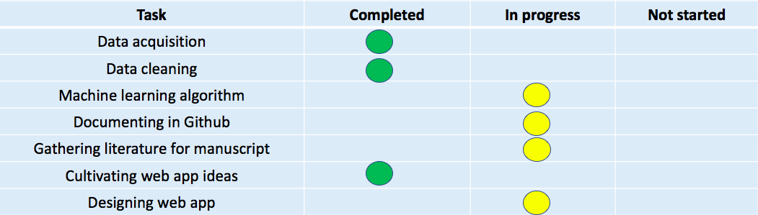
Team 1 Progress Report

Slide 2

https://www.wtvq.com/2021/01/15/clark-county-teachers-react-to-vaccination-schedule/
About Home Risk Stratification Tool Resources Contact
We offer personalized information about the SARS-Cov2 vaccine side effects
To limit adverse events, patient information can be used to generate risk assessment data to help providers make informed decisions regarding patient care.
With the input of patient demographic information, we can perform a risk stratification using VAERSD data to predict the patient's possibility of an adverse event post vaccination.
Notes:
Add machine learning tab

Slide 3
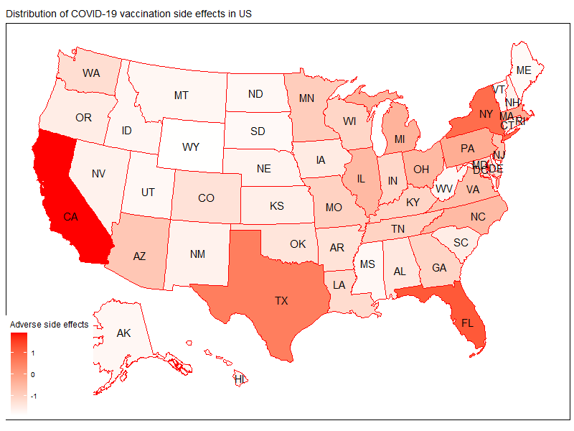
COVID-19 Vaccine Adverse Event Predictor
About Home Risk Stratification Tool Resources Contact
Heatmap displaying the SARS-Cov2 vaccine side effects
US Geographical Region
Northeast:
New England:
(Connecticut, Maine, Massachusetts, New Hampshire, Rhode Island, and Vermont)
Middle Atlantic
(New Jersey, New York, and Pennsylvania)
South
South Atlantic
(Delaware, Florida, Georgia, Maryland, North Carolina, South Carolina, Virginia, District of Columbia, and West Virginia)
East South Central
(Alabama, Kentucky, Mississippi, and Tennessee)
West South Central
(Arkansas, Louisiana, Oklahoma, and Texas)
Midwest
West North Central
(Iowa, Kansas, Minnesota, Missouri, Nebraska, North Dakota, and South Dakota)
East North Central
(Illinois, Indiana, Michigan, Ohio, and Wisconsin)
West
Mountain
(Arizona, Colorado, Idaho, Montana, Nevada, New Mexico, Utah, and Wyoming)
Pacific
(Alaska, California, Hawaii, Oregon, and Washington)
US Territories
Based on patient demographic information, risk stratification using VAERSD data has been mapped to geographical areas of the United States

Slide 4
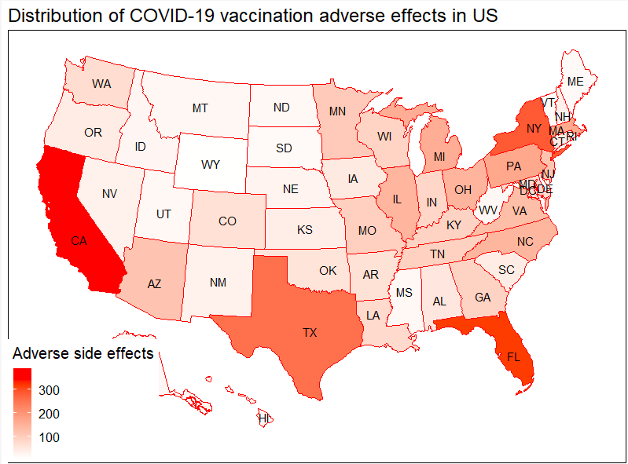
Notes:
Raw counts

Slide 5
COVID-19 Vaccine Adverse Event Predictor
About Home Risk Stratification Tool Resources Contact
Enter Patient Demographics
For all questions, select from dropdown menu (all fields are compulsory)
Patient Gender
Male
Female
Patient
Age
18-40
40-65
65+
Vaccine Manufacturer
Pfizer
Moderna
Medical Comorbidities
Asthma
Diabetes
Depression
Obesity
…
…
None
US Geographical Region
Northeast
New England
Middle Atlantic
South
South Atlantic
East South Central
West South Central
Midwest
West North Central
East North Central
West
Mountain
Pacific
US Territories
Allergies
NKDA
Codeine
Peanuts
Bee Sting
Sulfa drugs
Penicillin
Seafood
None
Is the patient physically disabled?
Yes
No
Submit

Slide 6
COVID-19 Vaccine Adverse Event Predictor
About Home Risk Stratification Tool Resources Contact
With the entered demographics, the patient has an 20% probability of experiencing an adverse event:
chest pain (15%) and shortness of breath (5%).
It is suggested that increased surveillance and a response plan is put in place to reduce the risk of a poor patient outcome.
Adverse Event Risk Prediction
Adverse Event or Symptom

Slide 7
COVID-19 Vaccine Adverse Event Predictor
About Home Risk Stratification Tool Resources Contact
Ensuring COVID-19 Vaccine Safety in the US visit the link :
https://www.cdc.gov/coronavirus/2019-ncov/vaccines/safety.html
Adverse Event or Symptom

Slide 8
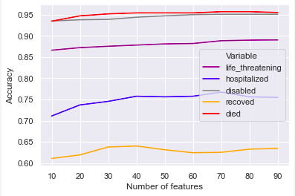
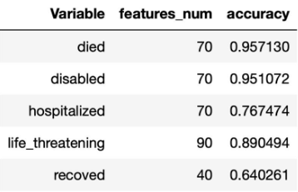
Notes:
cleaned data
Ran model for all features 12,500 features created from less than 30
Feature selection is whats being showed here

